Slide 1
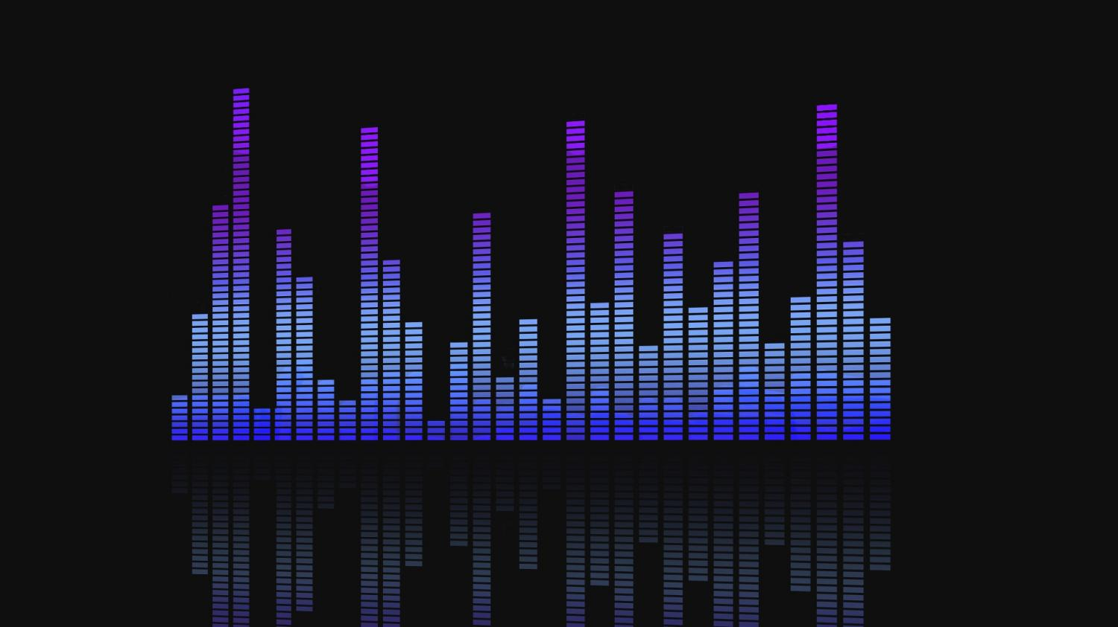
Audio BIBLE
aitor Vélez tolosa

Slide 2

What is an audio bible?
-An audio bible is a document that establish a big vision of how will the audio design look like.
-The objective of this document is to make all people involved in the game development to understand how will be the audio.
-Is a very descriptive document that can’t give doubts about how will be the final audio design.

Slide 3

The audio designer and its responsibilities
-Overall game sound including music and sound effects.
-The sound supports the gameplay and player’s experience.
-Gather all sound material for the game.
-Responsible for all sound design related aspects
-Responsible of the audio bible.

Slide 4
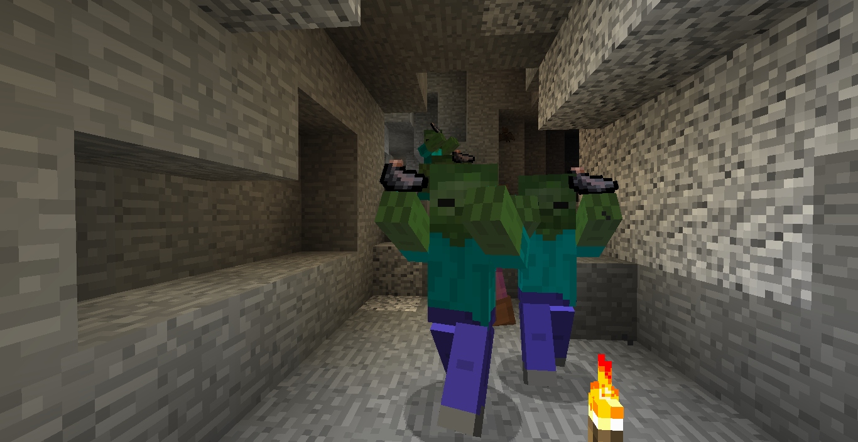
Importance of sound in videoGames
-It gives signals to the player:
-It provides the player instant feedback:
-Music is a powerful tool to drive emotion

Slide 5
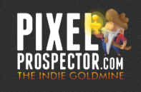

Before writing the audio bible
Chech out this websites for quality free sounds:

Slide 6

Before writing the audio bible
-Learn about experience as a player and also pay attention when playing.
-Make sure that sounds and music are compatible.
-Include sound into the game as soon as posible.
-Take notice off other games where audio did not work

Slide 7
Main elements
Music
Sound Design
Voice over

Slide 8
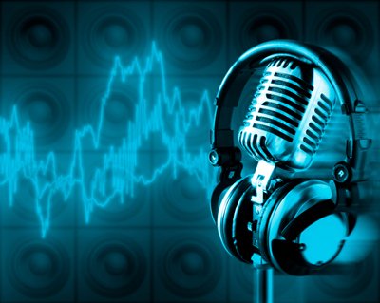

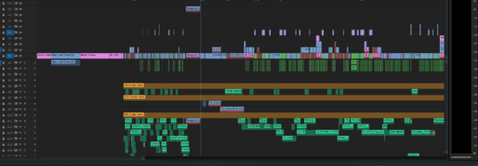
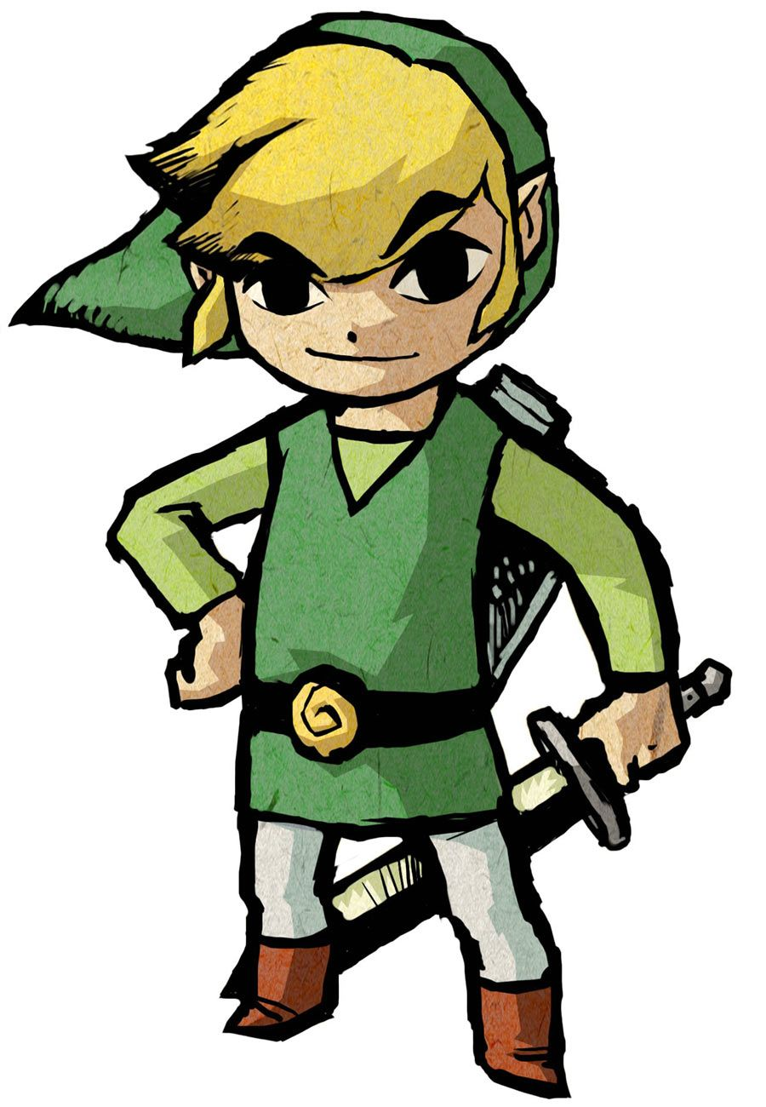
Main elements(Music)
-Style
-Instrumentation:
-Recording:
-Implementation:

Slide 9
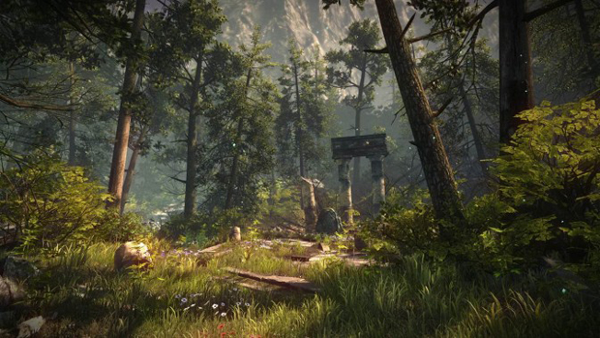

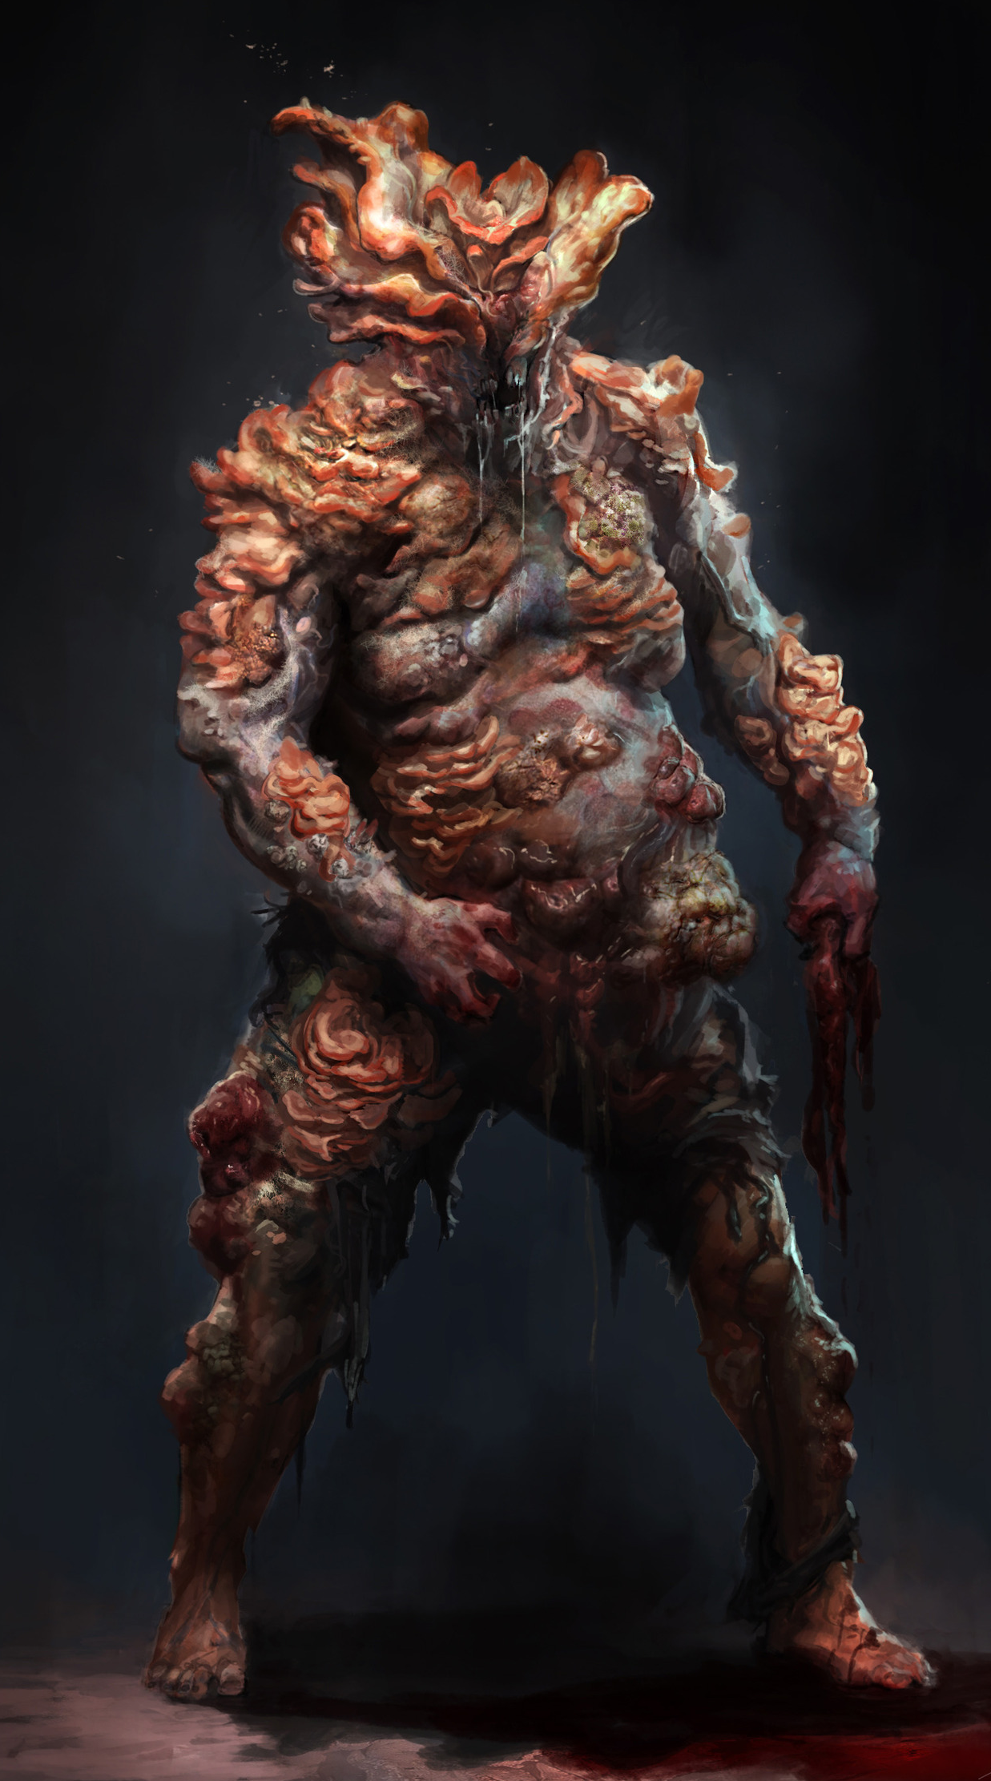
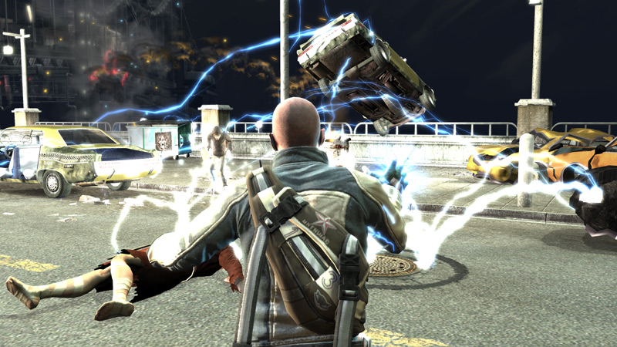
Main elements(sound design)
Ambience:
Weapons/Items
Creatures/Enemies
Visual Effects
Players

Slide 10

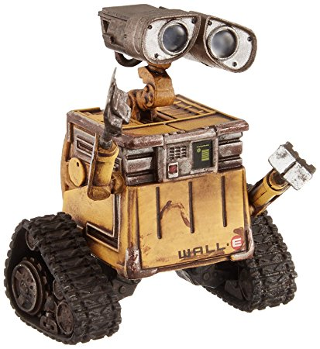
Main elements (Voice over)
-People needed for the creation of voices
-Types of voices required
-Artifitial voices

Slide 11
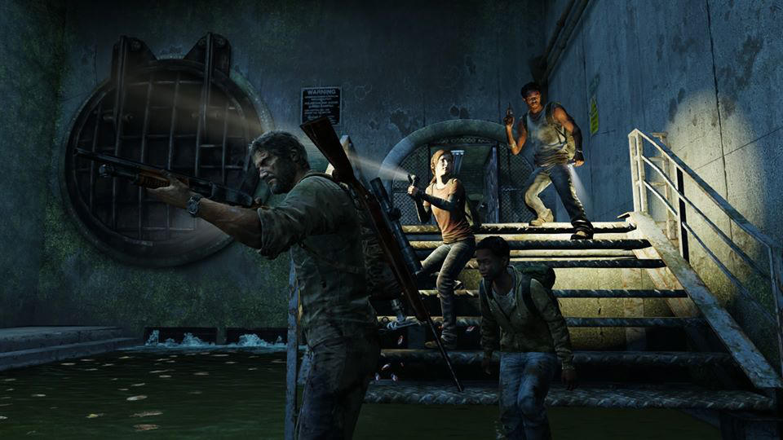
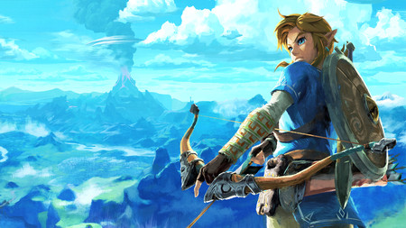
Establish reference material
Taking points of reference: Clips
Music
Voice over

Slide 12
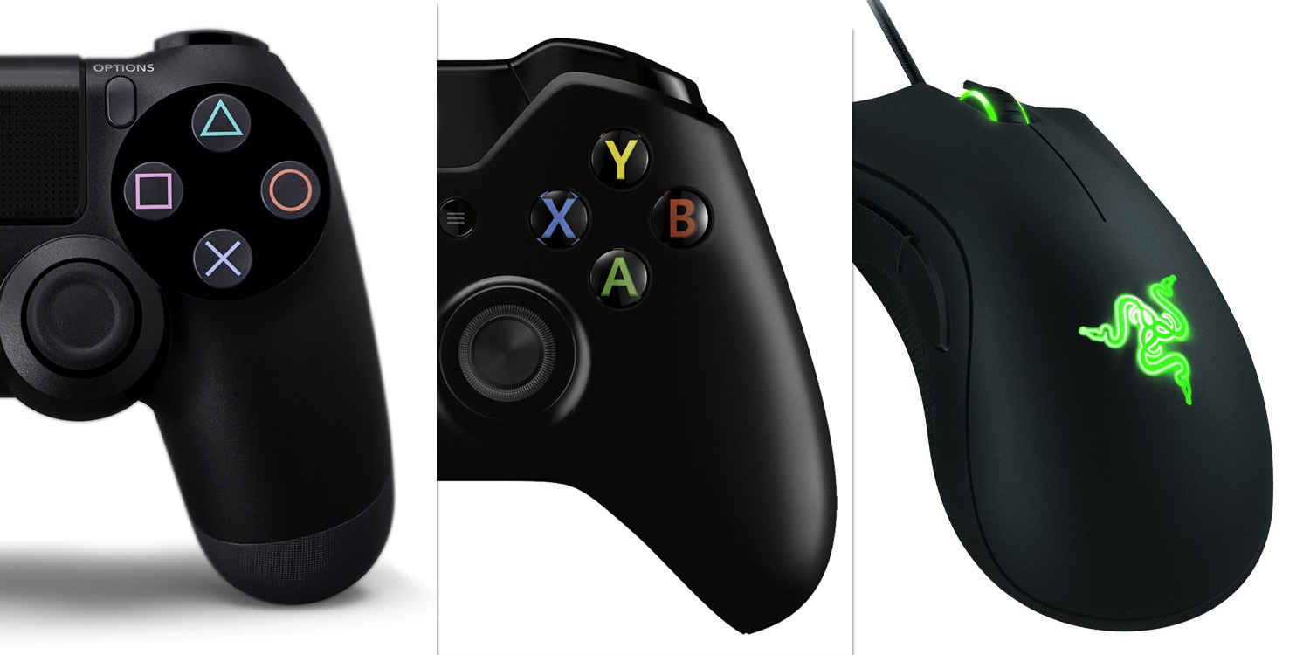

Establish technology requirements
Number of platforms that need to be supported
Multiplayer requirements (Over network? Split-screen? How many players?)
Memory and streaming limitations
Environmental Effects (DSP)

Slide 13

Exercice
Given this video, make a list of what sounds must have the scene according to music, sound effects and voice over and use classificate the sound effects as shown before.
Ambience:
Weapons/Items
Creatures/Enemies
Visual Effects
Players

Slide 14
REFERENCE

Slide 15
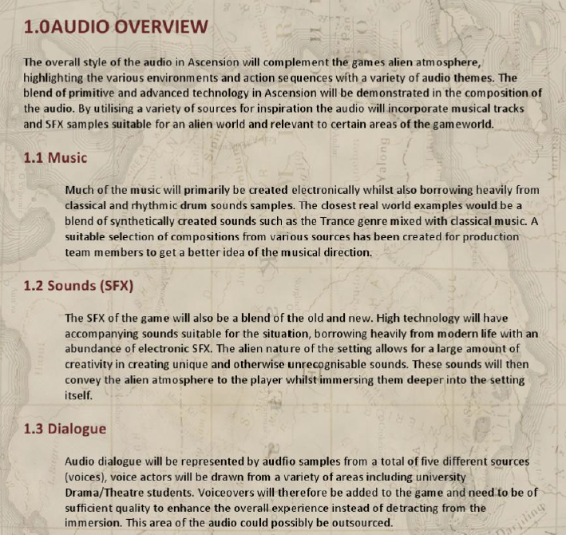
Audio bible structure ( 1.Audio overview)

Slide 16

Audio bible structure ( 2.Defining audio content)
2.1 What parts of the game should have music?
2.2 What style of music is best for this game?
2.3 When should the music be ambient and when should it be intense?
2.4 How will the music to transition?
2.5 Are character themes appropriate?
2.6 Are there aspects of the gameplay that would benefit from the music?

Slide 17
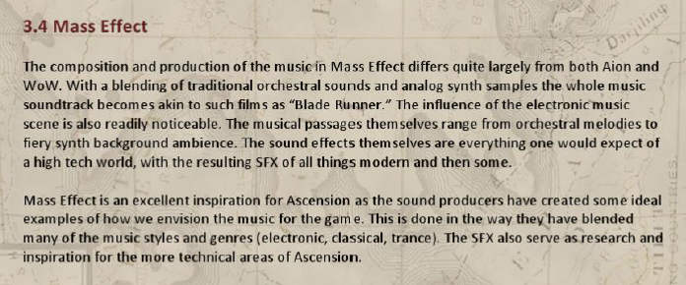
Audio bible structure ( 3. audio inspiration)
Example:

Slide 18
Audio bible structure ( 4. Audio design direction)
-Music style: What’s the style of the music
-Production values: Here it is described how the assets have been produced.
-Mood Ranges: In different zones of the game, the music will have a different feel.

Slide 19
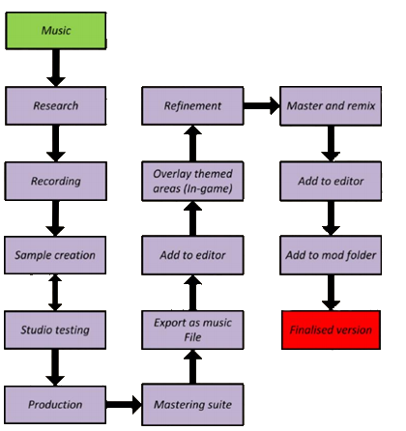
Audio bible structure ( 4.Production pipelines)

Slide 20
Audio bible structure ( 6.content descriptions)
-All SFX, music and dialogues described.

Slide 21
Audio bible structure ( 7.audio assets)
Main music themes are listed here, however additional themes will be created if time allows during produciton.
ID | Audio name | Description
AM_01 | AA_Music01_Mt | Main Theme
AM_02 | AA_Music02_Py | Port of Yagomir theme
AM_03 | AA_Music03_Ai | The Auir Theme
AM_04 | AA_Music04_Rn | Ruins of Nyzal theme
AM_05 | AA_Music05_Bt | Battle theme
AM_06 | AA_Music06_At1 | Additional track 1
AM_07 | AA_Music07_At2 | Additional track 2

